Slide 1

Impact of Overworking
Presented by Caroline Kuo
27 November, 2024
Notes:
"Good afternoon, everyone. My name is Caroline Kuo, and today I will present on the Impact of Overworking. We’ll explore its societal effects, economic implications, and potential solutions for employers. Let’s dive in."

Slide 2

Are you also a member of the overworked club?
Notes:
"Let’s make this interactive. Please take a moment to think back to last week—how many hours did you work in total? Raise your hand if you worked more than 40 hours. [Pause to observe hands] Thank you! As we can see, overworking is not an isolated issue. It’s something that many of us, in this room and beyond, experience regularly."

Slide 3



Please download and install the Slido app on all computers you use
How many hours did you work last week?
ⓘ Start presenting to display the poll results on this slide.
Notes:
"Let’s make this interactive. Please take a moment to think back to last week—how many hours did you work in total? Raise your hand if you worked more than 40 hours. [Pause to observe hands] Thank you! As we can see, overworking is not an isolated issue. It’s something that many of us, in this room and beyond, experience regularly."

Slide 4
Weekly Working Hours
Worked over 40 hours a week
40%
18%
Worked over 60 hours a week
Notes:
"Globally, 40% of employees report working over 40 hours per week, and 18% admit to working more than 60 hours weekly. These numbers aren’t just statistics—they represent real lives, struggles, and sacrifices. Let’s consider how these trends impact individual well-being and organizational performance."

Slide 5
Reasearch Question
Does excessive working hours have a detrimental impact on society, and are there solutions for employers?
Notes:
"Here’s the key question we’ll tackle today: Does excessive working hours have a detrimental impact on society, and are there solutions for employers? By the end of this presentation, I hope to provide some answers to this important question."

Slide 6
Average Weekly Working Hours Worldwide (2023)
Source: ILO
Notes:
"This map illustrates average weekly working hours worldwide in 2023. Notice how countries in Asia and Africa often show significantly higher weekly hours compared to other regions. This suggests systemic challenges in these areas, such as a reliance on labor-intensive industries and less regulatory oversight on working conditions. These factors contribute to longer hours and the associated risks."

Slide 7
Annual hours worked per worker by countries (2023)
Source: OECD data
Notes:
"This chart shows annual hours worked per worker by country. While countries like Germany and the Netherlands work fewer hours annually, they still achieve high productivity. In contrast, the United States, with an average of 1,800 annual hours, works significantly longer. This raises an important question: How can countries balance workload with efficiency and productivity?"

Slide 8

What does overwork bring?
Increased risk of health issues:
People who work long hours (more than 55 hours per week) have a 33% higher risk of stroke.
Burnout:
According to a study in 2020, out of 2,474 nurses, 12.3% reported high levels of burnout symptoms during the early stages of their careers.
Lower productivity:
A research has shown that one in ten employees worked an extra day of unpaid overtime every week in 2021.
Notes:
"Overworking leads to serious consequences. First, health risks: people working over 55 hours a week have a 33% higher risk of stroke. Second, burnout: studies show 12.3% of nurses reported high levels of burnout symptoms. Finally, lower productivity: research has found that 1 in 10 employees works an extra day of unpaid overtime each week. These challenges are widespread and demand our attention."

Slide 9



How common is burnout?
7 out of 10
people have had contact with burnout
5 out of 10
people feel stressed
and have exprienced burnout
8 out of 10
people take burnout seriously
Notes:
"Let’s quantify the issue of burnout: 7 out of 10 people have experienced it, while 5 out of 10 feel stressed regularly. Interestingly, 8 out of 10 believe burnout is a serious issue that should be addressed. These numbers underline the urgent need for better workplace policies and support systems."

Slide 10
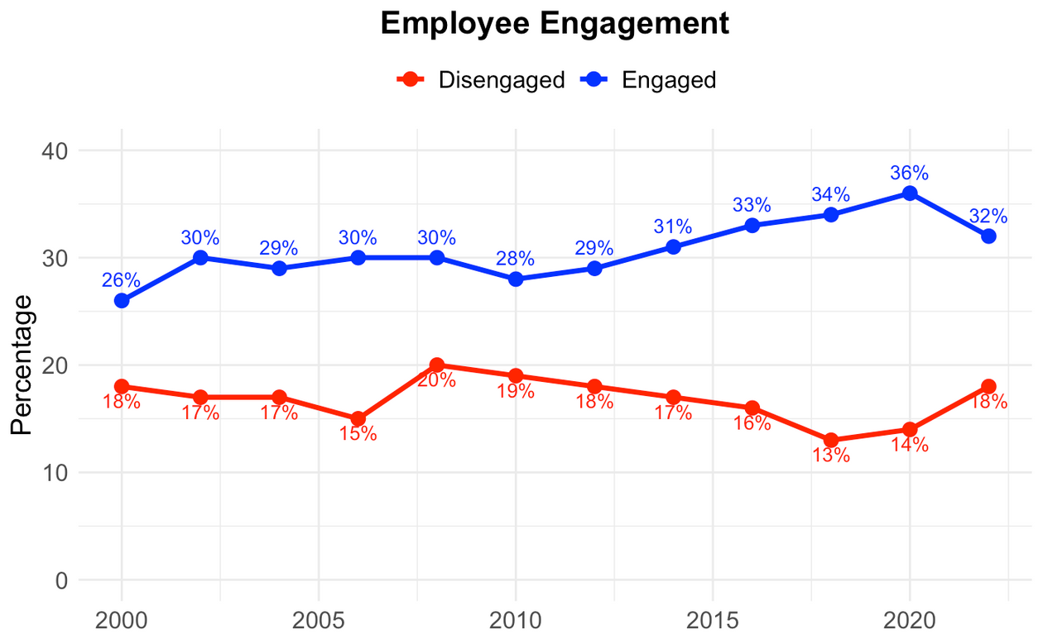
Burnout
an increased number of actively disengaged employees (from 13% to 18%) could mean quiet quitting is on the rise.
Notes:
"Burnout is also tied to quiet quitting, a phenomenon where employees don’t officially leave their jobs but disengage and stop performing efficiently. Examples include missing deadlines, completing only the bare minimum, or withdrawing from collaborative tasks. The increase in disengaged employees from 13% to 18% suggests quiet quitting is becoming more prevalent. This highlights the need for better engagement and motivation strategies in workplaces."

Slide 11
What does overwork bring?
Increased risk of health issues:
People who work long hours (more than 55 hours per week) have a 33% higher risk of stroke.
Burnout:
According to a study in 2020, out of 2,474 nurses, 12.3% reported high levels of burnout symptoms during the early stages of their careers.
Lower productivity:
A research has shown that one in ten employees worked an extra day of unpaid overtime every week in 2021.
Notes:
"Now, let’s focus on lower productivity. To explore this, I’ll present a combination of charts and regression analysis to demonstrate the relationship between working hours and productivity. By looking at the data, we can better understand how overworking may lead to diminishing returns in output and performance."

Slide 12
Labor Productivity vs. Working Hours
Source: BLS
Notes:
"Here, we see the 2023 Hours Worked Index by state. The darker shades on the map represent states with higher average working hours. Notably, states like Texas, Nevada, and Colorado exhibit some of the darkest shades, indicating significantly higher working hours compared to other states. This geographic pattern suggests that these areas might have industries or labor practices demanding longer hours. However, as we will explore in the next slides, higher working hours do not always equate to higher productivity. This data invites us to investigate further the relationship between labor input and output."

Slide 13
Labor Productivity vs. Working Hours
Source: BLS
Notes:
"This slide focuses on labor productivity indices by state for 2023. Unlike the previous map, here darker shades represent higher productivity levels. States such as Washington, California, and New York show darker shades, highlighting higher productivity levels. Interestingly, these states don’t align perfectly with the highest working hours observed earlier, suggesting that productivity is influenced by factors beyond just the number of hours worked. For example, investments in technology, education, and workplace efficiency could play a key role in boosting productivity in these regions. This contrast underscores the complexity of the relationship between hours worked and labor output."

Slide 14
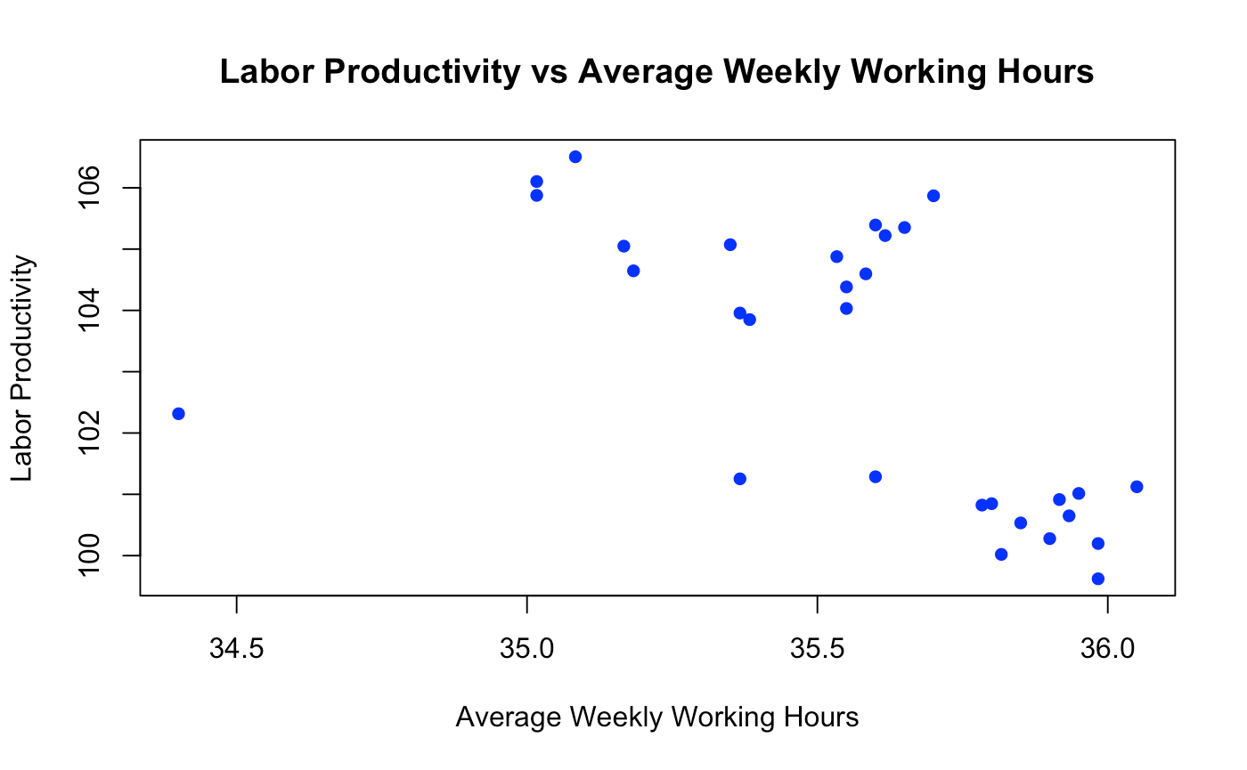
Lower productivity
Source: BLS
Notes:
"This scatterplot, using data sourced from the Bureau of Labor Statistics (BLS), demonstrates the relationship between labor productivity and average weekly working hours across the dataset. Contrary to what one might assume, the data indicates that higher working hours do not necessarily result in higher labor productivity. In fact, as working hours increase, productivity shows signs of decline in many cases. This suggests that overworking may lead to diminishing returns in output and overall performance."

Slide 15


Regression_Variables
Dependent Variable:
Labor productivity (LP)
Independent Variables:
Average Weekly Working Hours (WH)
Hourly Compensation (HC)
Output per Worker (output)
Unit Labor Costs (LC)
Value-Added Output (outputVA)
Notes:
"In this analysis, labor productivity is the dependent variable, representing the efficiency of output per unit of labor input. The independent variables include average weekly working hours, hourly compensation, output per worker, unit labor costs, and value-added output. Among these, only average weekly working hours serves as the main explanatory variable, while the others are included as control variables to isolate the effect of working hours on productivity. Let’s briefly explore the economic significance of each variable and its relationship to the dependent variable:
Average Weekly Working Hours (WH): This variable measures the average number of hours employees work each week. It directly impacts labor productivity by influencing efficiency and output levels.
Hourly Compensation (HC): Reflects the cost per hour of labor. Higher compensation could motivate employees or reflect higher skills, which might positively correlate with productivity.
＊Output per Worker (Output): Represents the average output generated by an individual worker. This metric inherently reflects labor productivity and serves as a control to isolate other factors.
Unit Labor Costs (LC): Measures the labor cost associated with producing one unit of output. A negative relationship with labor productivity suggests higher efficiency with lower costs.
Value-Added Output (OutputVA): Indicates the value addition contributed by labor to the production process. Higher value-added output often aligns with increased labor productivity.

Slide 16
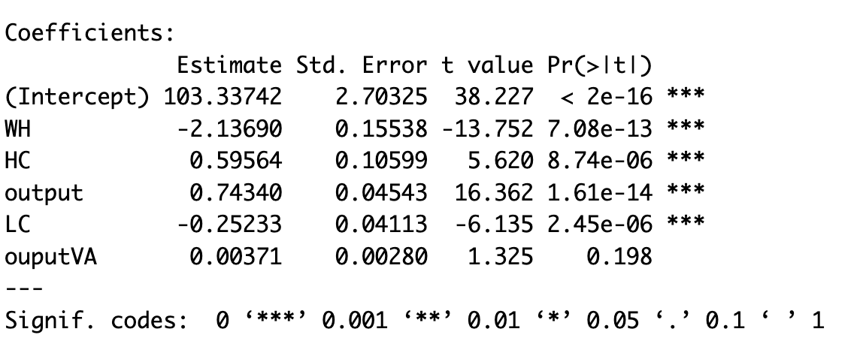
Regression Model
Labor Productivity=
β0​+β1​(Average Weekly Working Hours)+β2​(Hourly Compensation)+β3​(Output per Worker)+β4(Unit Labor Costs)+β5(Value-Added Output )+ϵ
Notes:
"We analyzed the data using R, and the results reveal two significant findings:
Labor Productivity and Average Weekly Working Hours: The coefficient for average weekly working hours is negative and statistically significant, indicating an inverse relationship. As working hours increase, labor productivity declines, demonstrating the diminishing returns associated with extended working hours.
Labor Productivity and Unit Labor Costs: Similarly, unit labor costs show a negative and significant relationship with labor productivity. This implies that higher labor costs per unit are linked to lower productivity, emphasizing the importance of efficient cost management in workforce planning.

Slide 17
Regression Model
Labor Productivity=
β0​+β1​(Average Weekly Working Hours)+β2​(Hourly Compensation)+β3​(Output per Worker)+β4(Unit Labor Costs)+β5(Value-Added Output )+ϵ

Slide 18


Regression Model
Average Weekly Working Hours (WH)
Labor Cost (LC)
negaticve estimated coefficient:
higher average weekly working hours, lower labor productivity.
negaticve estimated coefficient:
higher labor cost, lower labor productivity.
Notes:
"To better understand the relationship between these variables and labor productivity, let me provide two examples:
Working Hours and Productivity: In Germany, workers have shorter working hours but still achieve high productivity. This shows that working more hours doesn’t always lead to better results and can even reduce efficiency.
Labor Costs and Productivity: In manufacturing industries with high labor costs, companies often find it harder to stay efficient. This shows that higher labor costs can negatively affect productivity.

Slide 19
Solutions
Increasing Overtime Pay
Encouraging Automation
Protecting Employee Health
Promoting Efficiency
Boosting Morale
Improving Efficiency
Reducing Overtime Demand
Enhancing Product Quality
Increased Business Costs
Impact on Labor market
High Initial Investment
Changing Skill Requirements
Notes:
"So, what are the solutions? Two key approaches stand out:
Increasing Overtime Pay:
Advantages: Protects employee health, boosts morale, and promotes efficiency.
Disadvantages: Increases business costs and may impact the labor market by discouraging hiring.
Encouraging Automation:
Advantages: Reduces overtime demand, improves efficiency, and enhances product quality.
Disadvantages: Requires high initial investment and changes skill requirements for workers.
“Both strategies require balancing short-term costs with long-term benefits."

Slide 20

Potential Challenges
Regression model
relatively high R squared
insufficient data
Impact on Labor-Intensive Industries
especially for some countries’ labor cost is relatively low,
Notes:
"Implementing these solutions is not without its difficulties. From our regression model, the R2R^2R2 value approaches 0.9. This high value could be due to using time-series data, suggesting that finding and including more relevant variables could help capture more variation and improve the model's accuracy.
When it comes to solutions, raising overtime pay may not be the most suitable option for labor-intensive countries. In many of these nations, an oversupply of labor leads to low wages. Increasing overtime pay could erode the advantage of cheap labor, potentially driving factories to relocate and increasing economic risks.

Slide 21
Conclusion
"Empower the Workforce, Evolve the Workplace"
Notes:
"In conclusion, we must rethink the traditional work model. By empowering the workforce and evolving the workplace, we can create environments that are both productive and sustainable. Remember, it’s not about working harder—it’s about working smarter. Thank you, and I’m happy to take your questions."

Slide 22
Thank you

